Slide 1
Football Betting Market
Efficiency Analysis
A market-efficiency study with anomaly screening
8,915 matches · 4 leagues · 7 seasons · real Bet365 & Pinnacle odds
Vladislav Kivaev · Spiced Academy Berlin 2026
Notes:
Opening: framing as market-efficiency study, not match-fixing detector. No ground-truth labels exist.

Slide 2
OVERVIEW
The dataset
8,915
4
7
2
matches analysed
leagues
seasons · 2019/20 – 2025/26
bookmakers
Bet365 & Pinnacle
League | Country | Tier | Matches
Bundesliga | Germany | Elite | 2,142
EPL | England | Elite | 2,660
Süper Lig | Türkiye | Mid-tier | 2,447
Super League Greece | Greece | Mid-tier | 1,666
Notes:
Source: football-data.co.uk. Real Bet365 and Pinnacle opening and closing odds.

Slide 3
OVERVIEW
End-to-end pipeline
Python
PostgreSQL
dbt
Python
Streamlit
Extract data + EDA
AWS RDS storage
Transformation + tests
Modeling + SHAP
Dashboard
35 engineered features in 5 families: drift · spread · margin deviation · public–sharp gap · reversal
No team names or player data — only odds behaviour.
dbt tests | Features | Model | Scored matches
9 passing | 65 (35 per model set) | Isolation Forest | 8,915 rows
Notes:
dbt: 3 models. 9 passing tests. Two Isolation Forest models: universal + tier-aware.

Slide 4
BETTING 101
How odds work & where the margin hides
Outcome | Decimal | Implied %
🇲🇽 Mexico (home) | 1.48 | 67.6%
🤝 Draw | 4.33 | 23.1%
🇿🇦 South Africa | 6.50 | 15.4%
Total |  | 106%
Result: Mexico won 1–0
The extra 6% above 100% is the house margin — built into every price. Profitable betting requires finding edges larger than this margin consistently.
Bet365 closing margin by league (%)
Notes:
Key: implied probability = 1/decimal odds. Overround = sum of implied probabilities > 1.

Slide 5
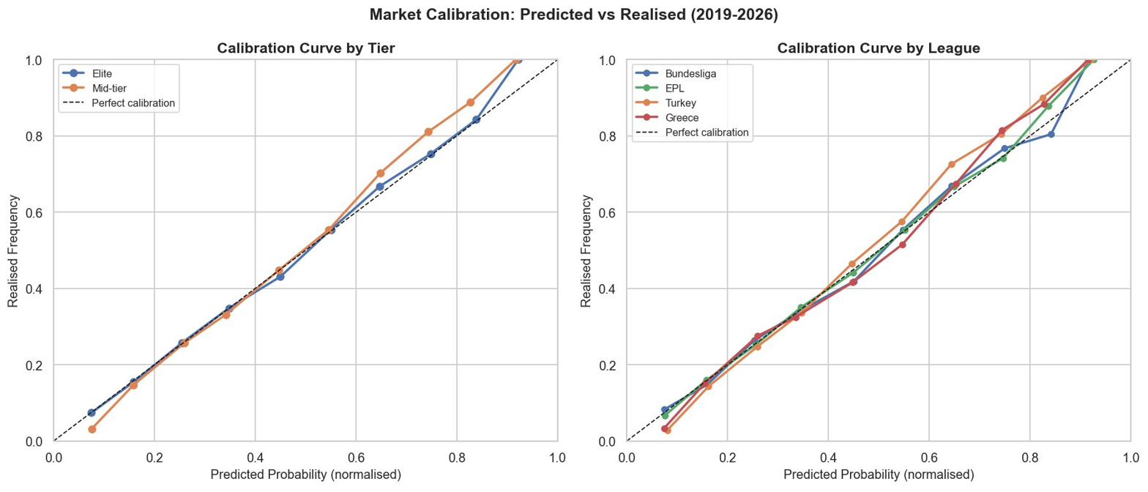
MARKET EFFICIENCY
The market is remarkably accurate
r = 0.999
43%
53.1%
+1.5pp
predicted vs actual
calibration
home-win rate
favourites win
Greece draw gap
Calibration uses normalised probabilities (margin stripped out). r=0.999 confirms near-perfect accuracy — but this doesn't imply profitable betting once the 6% margin is restored.
Notes:
Calibration line ends at ~83% — the 90-100% bucket has only 5 matches, below the minimum threshold of 10.

Slide 6
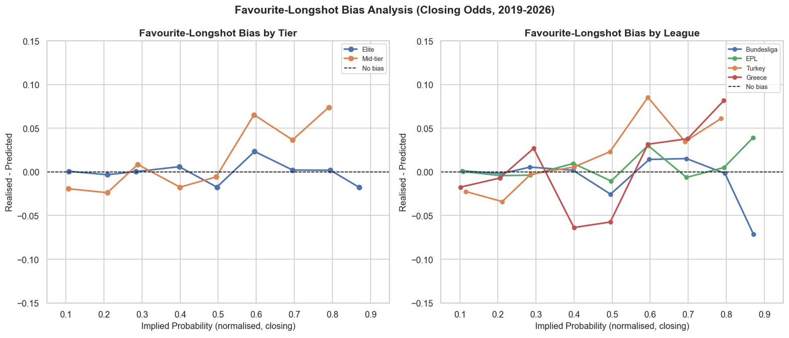
MARKET EFFICIENCY
Favourite–longshot bias — zoomed in
Positive gap = outcome happened more than implied (underpriced). Favourites (60–80% implied) are slightly underpriced (+2–4pp). Longshots (10%) are slightly overpriced (−1pp). Gaps are real but too small to overcome the 5–7% margin.
Notes:
Classic FLB: recreational bettors overbet longshots, bookmakers shade those prices down, favourites relatively underpriced.

Slide 7
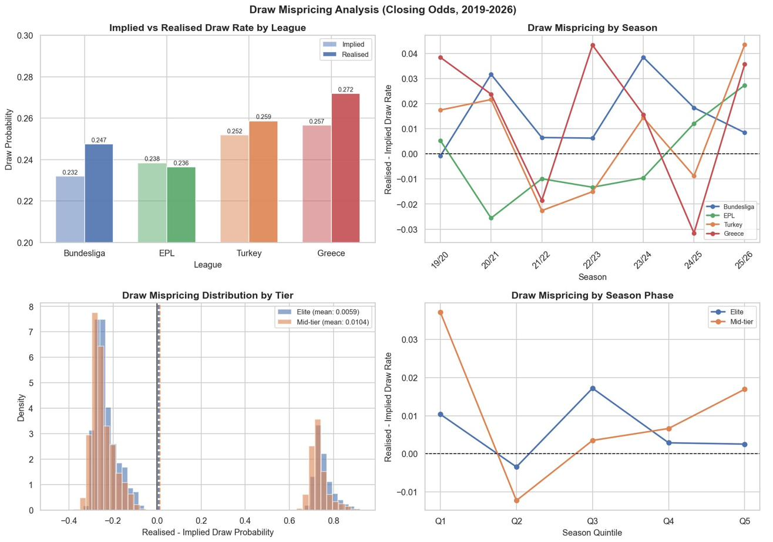
MARKET EFFICIENCY
Draws: systematic mispricing by league
EPL: implied 23.8% vs realised 23.6% — essentially correct. Greece: implied 25.7% vs realised 27.2% — draws happen +1.5pp more than the market expects, every season.
Notes:
H2 result: mixed. EPL correctly priced. Greece gap real and consistent but not statistically significant after correction at n=7.

Slide 8
ANOMALY DETECTION
Five signals — no team data by design
Drift
Public–sharp gap
The Isolation Forest learns what normal odds behaviour looks like across all 8,915 matches, then scores each match by how far it sits from that normal.
SHAP then splits the score into per-family contributions.
No team names, results, or player stats.
How far open → close odds moved
Bet365 vs Pinnacle divergence
Spread
Reversal
Disagreement between bookmakers
The two books moved the price in opposite directions
Margin deviation
Book's margin vs the typical margin
35 features in 5 families — no team or player data, by design.
Notes:
Isolation Forest: unsupervised. No labeled fixed matches needed. Contamination=0.05.

Slide 9
ANOMALY DETECTION
Greece flags at 10.6% — tier-aware model fixes it
Anomaly score distribution across all 8,915 matches.
Bell-shaped blue mass = normal odds behaviour.
Red tail on the right = top 5% by score — 446 matches flagged.
Score is a z-score: 0 = typical, higher = more anomalous.
Universal model over-flags structurally noisier markets like Greece (10.6%).
Tier-aware model re-scores against own league history — pulls every league toward 5%.
H3 pre-registered criterion met: gap cut by more than half.
Flag rate (%) by league
Notes:
H3 result: supported. Gap cut from 10.6% to 5.5%.

Slide 10
ANOMALY DETECTION
Why Greece — drift & spread across all 1,666 matches
Each bar = how much more that signal pushes Greek matches toward anomalous vs other leagues — averaged across ALL 1,666 Greek matches, not just flagged ones.
Drift (0.49) + Spread (0.47) together explain ~⅔ of Greece's elevated scores.
Greek odds move more late and bookmakers disagree more on prices — consistently, across seven seasons.
Four independent layers confirm this:
EDA · Model · SHAP · KS tests
Mean SHAP gap vs other leagues (scaled ×100 for readability)
Notes:
SHAP decomposes each match's anomaly score into per-family contributions. This chart averages the gap between Greece and all other leagues.

Slide 11
MATCH DASHBOARD
AEK Athens vs Volos · Greece · 2023-05-14
STATUS
RESULT
MODEL SCORE
TOP 0.1% MOST UNUSUAL
BET365 H/D/A
PINNACLE H/D/A
🚩 FLAGGED
Home win (1–0)
0.97
1.03 / 17.0 / 41.0
1.02 / 25.4 / 45.7
Spread & drift at 99th percentile = more extreme than 99% of all 8,915 matches.
Max Away odds: Bet365 41.00 vs Pinnacle 45.69 — gap of 4.69 decimal points.
Late away drift: +12.46 (Pinnacle open→close).
Bookmaker margin: 5.4% — close to dataset mean of 6.1%. Margin deviation is not the driver here.
Feature contribution — dataset-wide percentile (0–100)
Notes:
AEK Athens was a very heavy home favourite (1.03 odds). Extreme draw and away odds moved significantly late.

Slide 12
CONCLUSIONS
Four findings, two surprises
Market efficiency
Greece stands out
r=0.999 calibration across 8,915 matches. The market is broadly accurate — but accuracy ≠ profitability once the 6% margin is restored.
10.6% universal flag rate vs 5% target. Drift and spread explain ~⅔ of the gap across all Greek matches — not just suspicious ones.
Tier-aware model works
Two surprises
Re-scoring against own league history pulls every league to ~5%. Same logic as per-merchant calibration in fraud detection.
H1 rejected — Turkey is the outlier, not 'mid-tier as a block'. H4 rejected — spread falls at season's end in Greece, not spikes.
Methodology is directly applicable beyond football: any market with pre- and post-event pricing (financial instruments, e-commerce, insurance) benefits from the same pipeline — feature engineering on transaction signals → Isolation Forest → segment-aware calibration → SHAP attribution.
Notes:
Closing: domain is football, methodology is not. Honest null results strengthen the credibility of supported findings.

